Slide 1


INDUSTRIAL PROPERTY MARKET
REPORT Q2/2026
CROATIA
WWW.108REALESTATE.HR

Slide 2

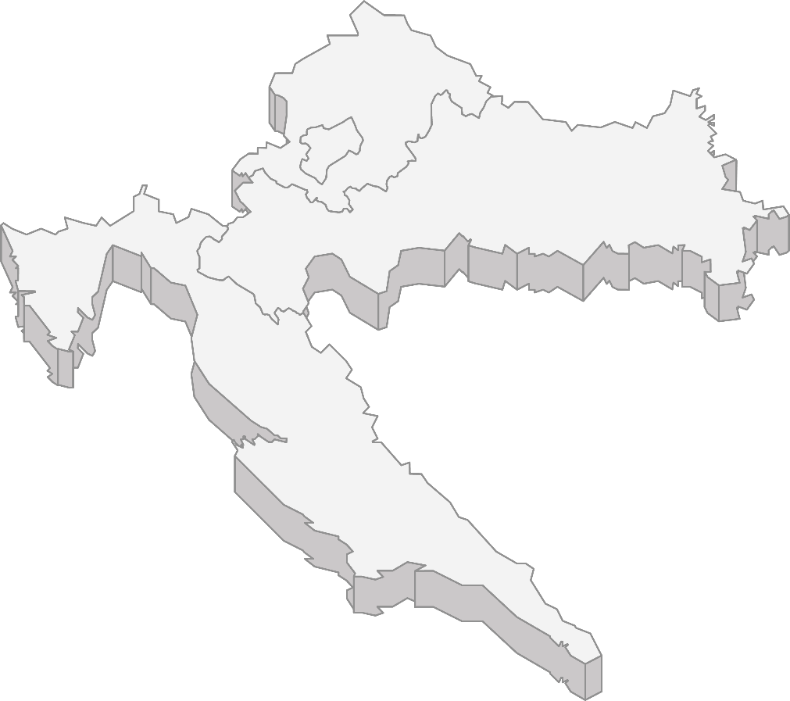
INDUSTRIAL MARKET IN CROATIA Q2/2026
SUPPLY AND DEMAND IN THE INDUSTRIAL MARKET: CONSISTENT ACTIVITY
450,000 sq m
TOTAL STOCK
18,417 sq m
NET TAKE-UP
165,000 sq m
UNDER CONSTRUCTION
6,25 EUR
AVERAGE RENTS
1.0 %
VACANCY RATE
0 sq m
PREMISES DELIVERED
Croatia's industrial and logistics market carried its constrained supply into Q2 2026, with leasing activity shifting toward Zagrebačka županija, which accounted for three of the four transactions recorded, against a single deal in Grad Zagreb.
The notable contributor to net take-up came from the manufacturing sector, spanning the chemical and building materials subsectors. Prime headline rents held stable at €6,50 per sq m per month, while vacancy tightened further to 1.0%, down from 2.1% in Q1, reflecting continued limited availability of modern product.
Croatia recorded 164,913 sq m under construction and 642,834 sq m planned, while stock of "A" class industrial premises for lease reached 450,065 sq m. Zero premises were delivered in Q2.
Croatia's economy grew 2.2% year-on-year in Q1 2026, its slowest pace since Q4 2020.
Croatia's inflation (CPI, year-over-year) eased over Q2 2026, ending the quarter at 4.5% in June, down from 4.8% in March.
SELECTION OF TRANSACTIONS AND RENTS
SIGNED TRANSACTIONS
UNDER CONSTRUCTION
COMPLETED CONSTRUCTION
PLANNED CONSTRUCTION
RC Zone Samobor
5,000 sq m
Quattro logistika
7,300 sq m
Accolade
312,000 sq m
LOGIS
Sv. Helena
39,000 sq m
Northern Croatia
6,00 – 6,50 EUR*
RC Zone Samobor
43,000 sq m
RC Zone
Klinča Sela
85,000 sq m
Pannonian Croatia
5,50 – 6,0 EUR*
City of Zagreb
6,50 – 7,50 EUR*
Logexpert
28,500 sq m
LOGEXPERT
Vukovina
58,000 sq m
Zadar
Cross-dock
18,500 sq m
Adriatic Croatia
6,50– 7,00 EUR*
VGP
Dugopolje
42,000 sq m
Note: * = EUR/sq m/month
Savska cesta 32 10000 Zagreb Croatia, +385 1 770 7108, +385 95 812 9767, info@108realestate.hr, www.108realestate.hr

Slide 3

Croatia's logistics and industrial property sector kept pace with broader trends across Southeast Europe during Q2 2026, as online retail fulfilment, contract logistics providers, distribution networks, and vehicle-sector tenants sustained occupier interest. The bulk of existing space still sits in and around Zagreb, though developers and investors are paying closer attention to emerging locations near Rijeka and Split as options closer to the capital grow scarcer. Within Croatia, most of the quarter's leasing was signed in Zagrebačka županija, and vacancy fell further to 1.0%, a sign that supply of "A"-class buildings isn't keeping up with occupier needs. Prime rents stayed flat at €6,50 per sq. m. per month, and no projects were completed during the quarter to ease that pressure.
TOTAL STOCK IN SQ M
VACANCY RATE %
Source: 108RE Research
Source: 108RE Research
PRIME RENTS – EUR/SQ M
GROSS TAKE-UP IN SQ M
Source: 108RE Research
Source: 108RE Research
„Looking beyond Q2 2026, Croatia's industrial and logistics real estate sector remains on a solid growth trajectory. Heading into Q3 2026, overall market conditions and occupier appetite are expected to hold steady. As part of the current under-construction pipeline reaches completion, availability in select submarkets should loosen somewhat, though this is unlikely to move the vacancy rate meaningfully in the near term. Even with ongoing inflationary pressure and lingering supply-chain disruption, the sector's trajectory should stay positive, carried by continued expansion and rising investor appetite.”
DARIO TOMLJENOVIC
Managing Director
Savska cesta 32 10000 Zagreb Croatia, +385 1 770 7108, +385 95 812 9767, info@108realestate.hr, www.108realestate.hr

Slide 4

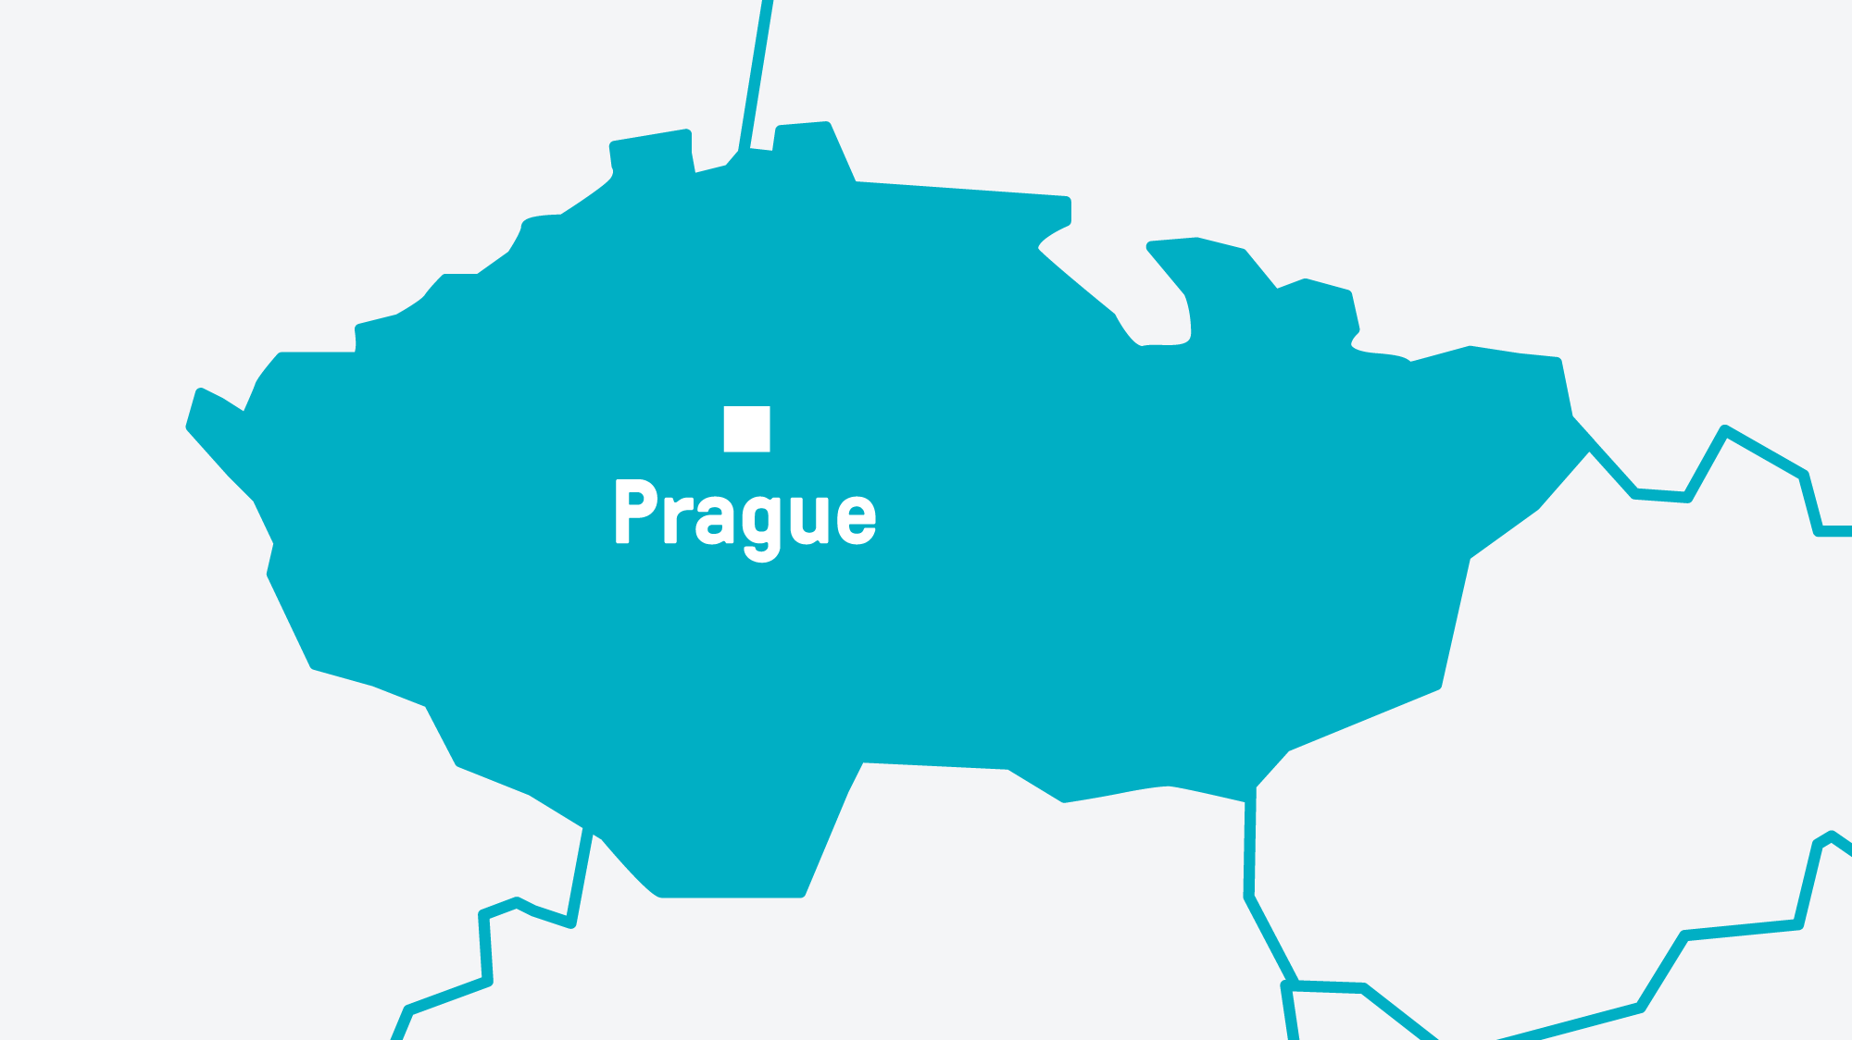
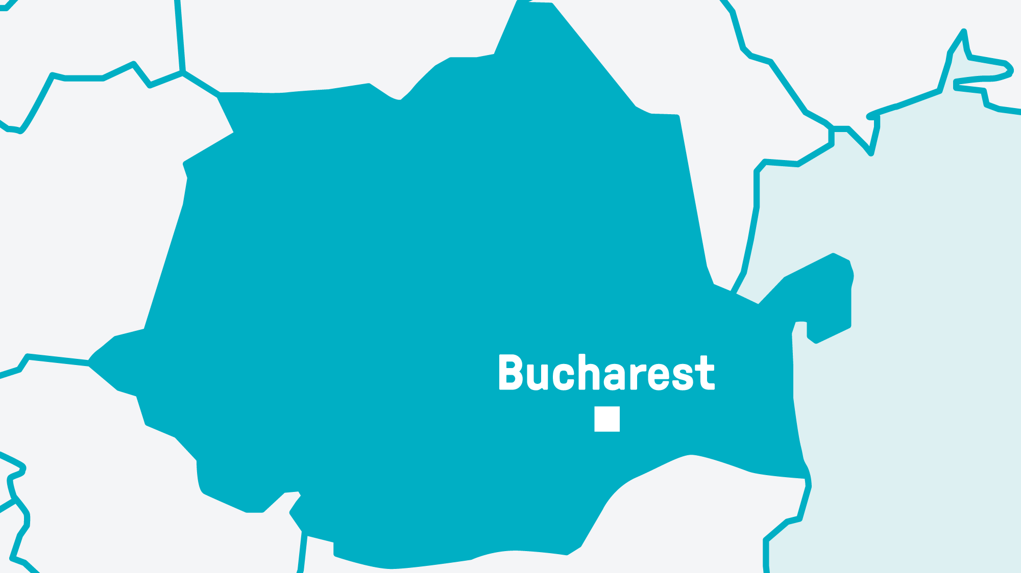
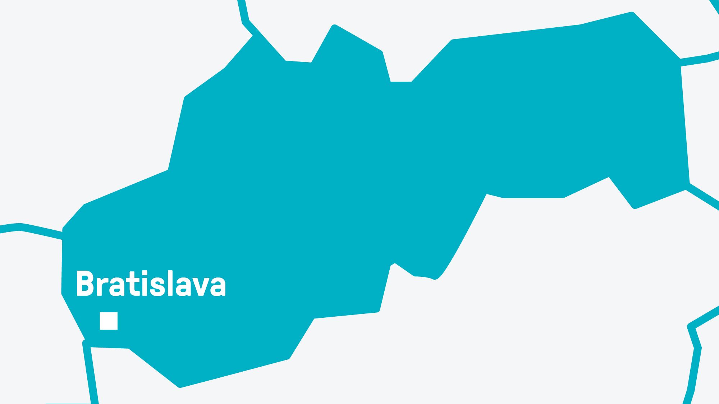
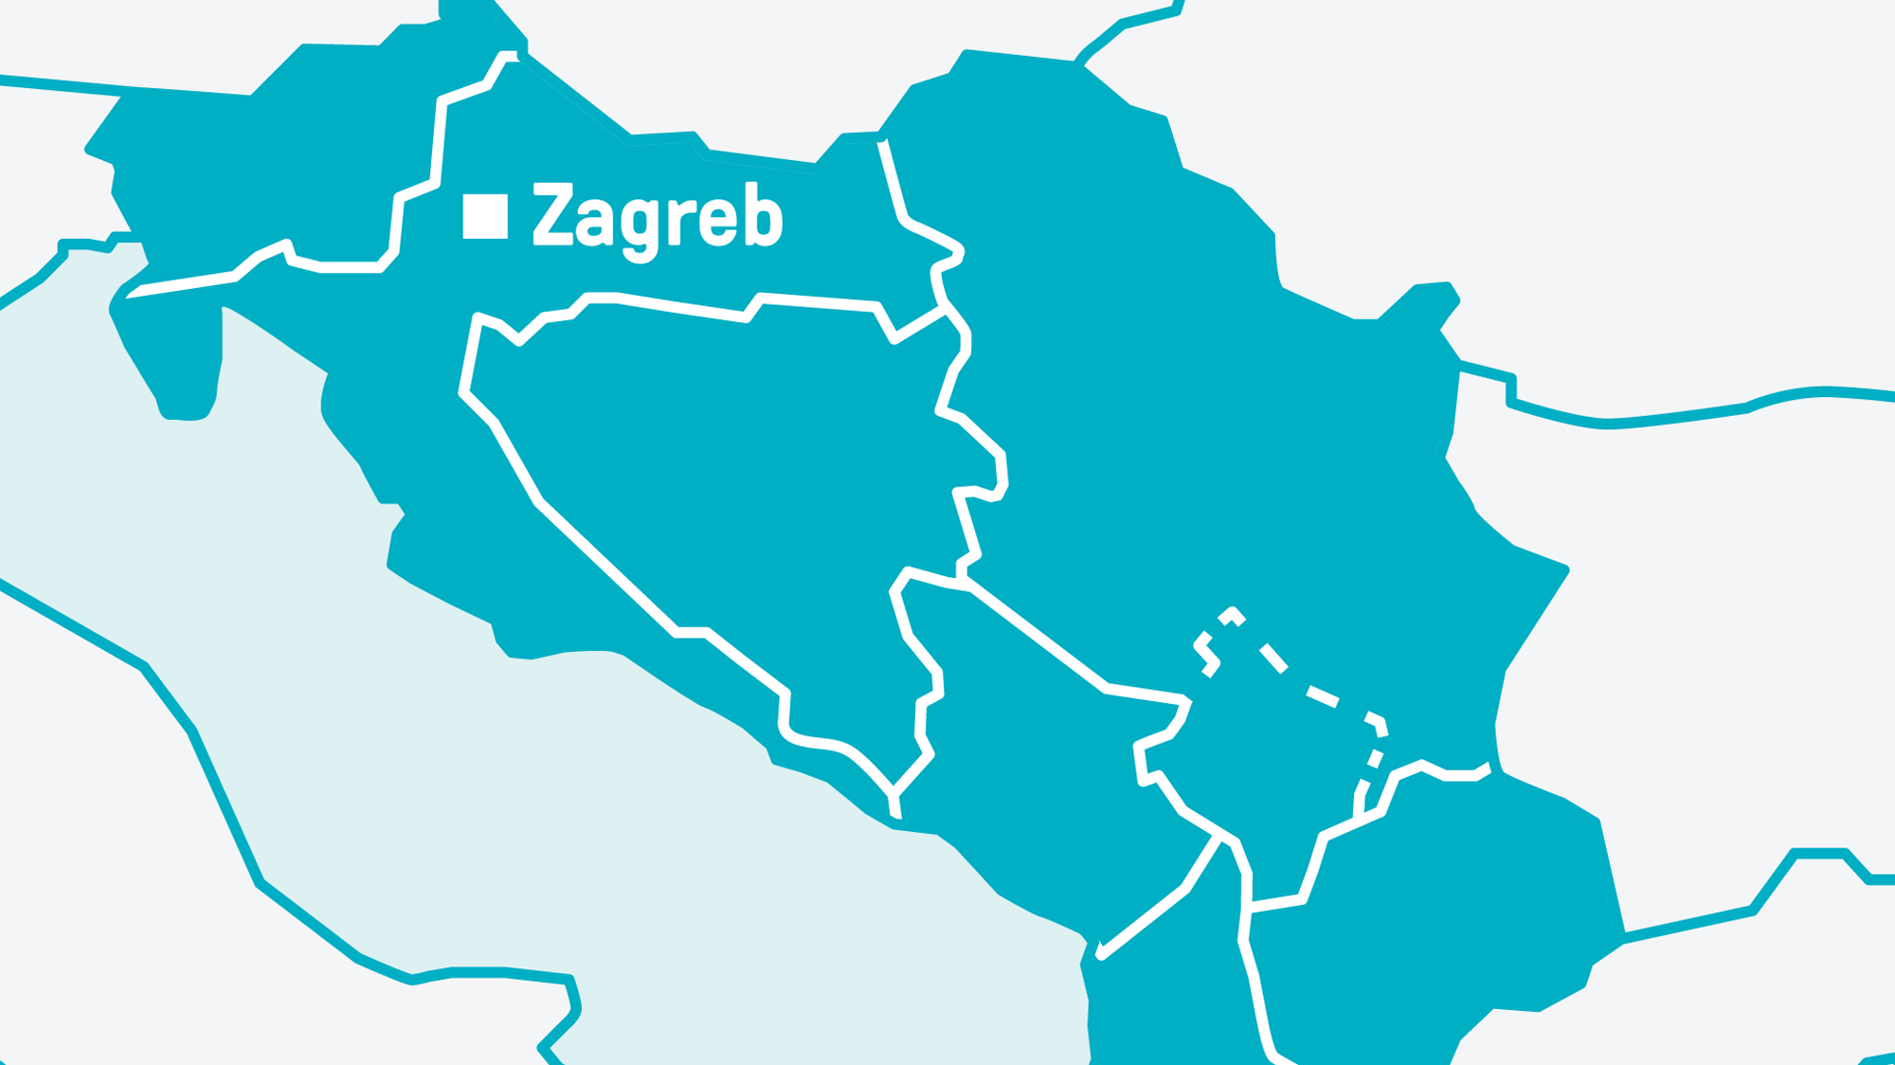
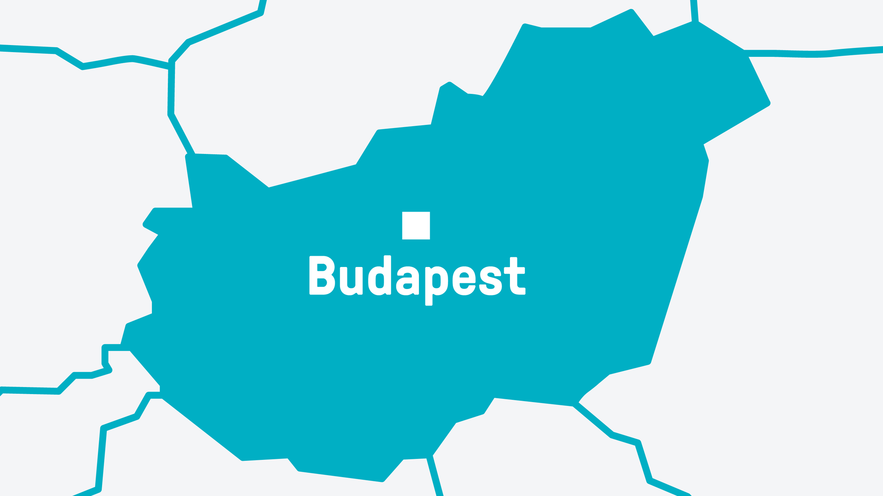

WE ARE COMMERCIAL
PROPERTY EXPERTS
With years of experience in the CEE market, we combine our knowledge of commercial properties with a personal approach.
We always keep up with technological advances and innovations to help our clients continuously grow and succeed.
1 000+
2 500+
3 000+
transactions
clients
properties
108 REAL ESTATE is a real-estate consulting agency which has been exclusively focused on commercial properties since 2009. Over the years, it’s over forty-member team has earned the trust of both domestic and foreign clients. 108 REAL ESTATE is the only commercial real-estate company on the European market which is one-hundred-percent Czech owned and run.
Since its founding, it has sold and rented more than 11.77 million square meters, and established a strong position on the Czech, Slovak and Hungarian markets. Clients turn to 108 REAL ESTATE for leasing and sales brokerage, investment and marketing advice, and development product management. At the end of 2021, 108 REAL ESTATE became the exclusive alliance partner of BNP Paribas Real Estate for the Czech Republic and became part of BNP network in whole of Europe.
^{PRAGUE}
^{Na Poříčí 1079/3a}
^{110 00 Praha 1}
^{Czech Republic}
⁺⁴²⁰ ²²² ²¹¹ ⁴⁶⁴
^{info@108realestate.cz}
^{BUCHAREST}
^{15 Charles de Gaulle Square}
^{011886 Bucharest}
^{Romania}
⁺ ⁴⁰ ⁷²² ²⁶³ ⁸⁶⁵
^{info@108realestate.ro}
^{BRATISLAVA}
^{Bottova 6067/1}
^{811 09 Bratislava}
^{Slovakia}
⁺⁴²¹ ⁹¹¹ ⁸¹¹ ⁷³⁰
^{info@108realestate.sk}
^{ZAGREB}
^{Savska cesta 32}
^{10 000, Zagreb}
^{Croatia}
⁺³⁸⁵ ¹ ⁷⁷⁰ ⁷¹⁰⁸
^{info@108realestate.hr}
^{BUDAPEST}
^{Ráth György utca 56}
^{1122, Budapest}
^{Hungary}
⁺³⁶ ⁷⁰ ⁹⁷⁷ ⁰⁰²¹
^{info@108realestate.hu}
^{NEW DELHI}
^{A 53, Sector 16, Noida}
^{Delhi-NCR, 201301}
^{India}
⁺⁹¹ ⁹³⁵ ⁴⁷³ ²²¹²
^{info@108realestate.in}

Slide 5
Jelena Kinsman – Business Development Manager
+385 1 770 7108
jelena.kinsman@108realestate.hr

